Slide 1
PocketData Benchmark
[Week #2]
Naveen, Sankar, Saravanan, Sathish

Slide 2
Progress
Classification based on business domain.
173 applications.
26 clusters
Finding features (In Progress)
Read & Write percentage,
Bursts,
Complexity of queries etc.

Slide 3
26 Clusters
System Services Utility Music Pre-Installed Networking
e-Commerce Messaging & Calls Game
Cloud Video Services Browser Image Forum New/RSS Reader
Cloud Storage Email Search eReader Dating
Navigation Media Player | Finance Health | Programming | Productivity | Personalization | Antivirus | Miscellaneous

Slide 4
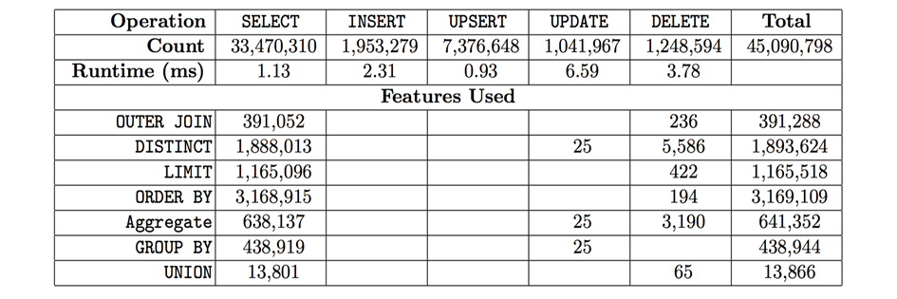
Observations from ‘Pocket Data: The Need for TPC-MOBILE’ paper
Types and numbers of SQL statements executed during the one-month trace
74% Select | 71% of INSERT/UPDATE statements are UPSERTS
~10% Select has Order By | Unions seldom used
Deletes are complex (Cache Invalidation: Invalidating the offline cache data as soon as it connects to internet?)
Reference: http://odin.cse.buffalo.edu/wp-content/uploads/2015/06/2015-TPCTC-SQLite-submitted.pdf

Slide 5
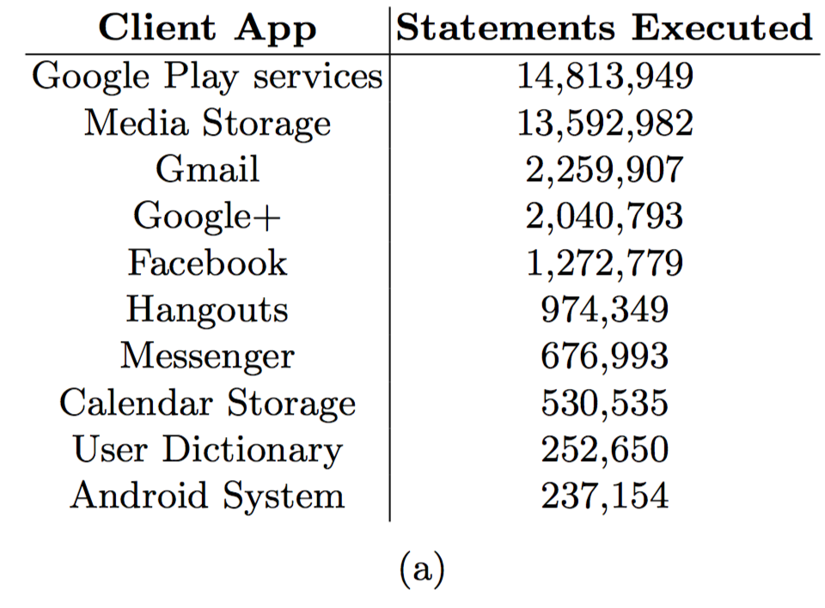
Observations from ‘Pocket Data: The Need for TPC-MOBILE’ paper
33% queries from a single service
63% queries summing up top two services
Reference: http://odin.cse.buffalo.edu/wp-content/uploads/2015/06/2015-TPCTC-SQLite-submitted.pdf

Slide 6
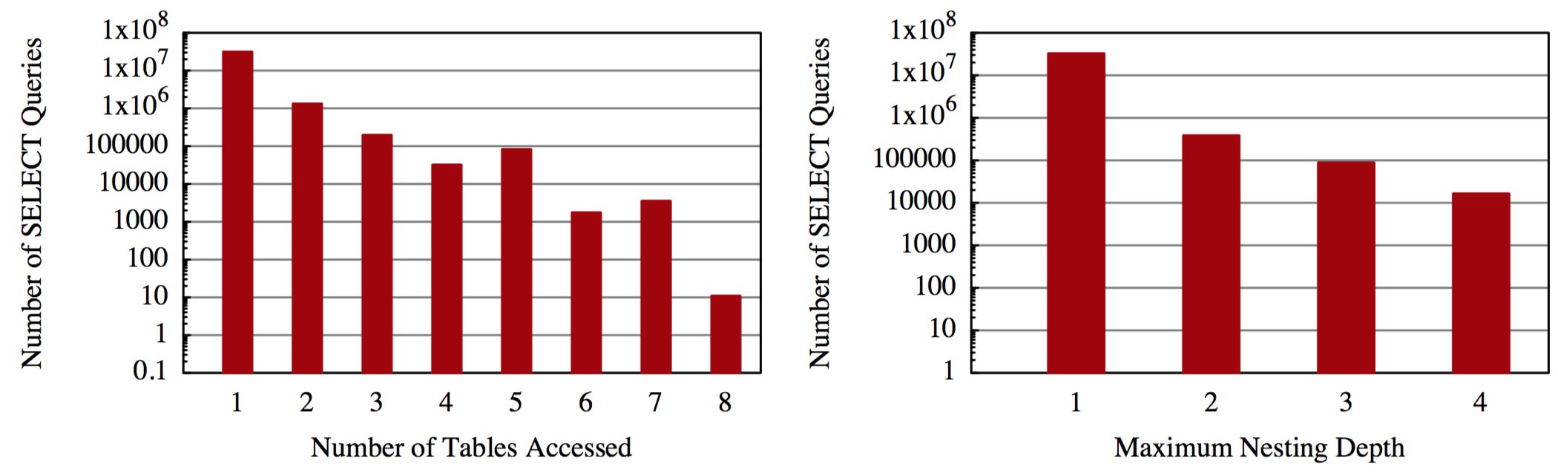
Observations from ‘Pocket Data: The Need for TPC-MOBILE’ paper
86% of all queries are simple single table scans/look-ups.
Extreme – ‘Google Play Services’ queries accessing 8 distinct tables.
Reference: http://odin.cse.buffalo.edu/wp-content/uploads/2015/06/2015-TPCTC-SQLite-submitted.pdf

Slide 7
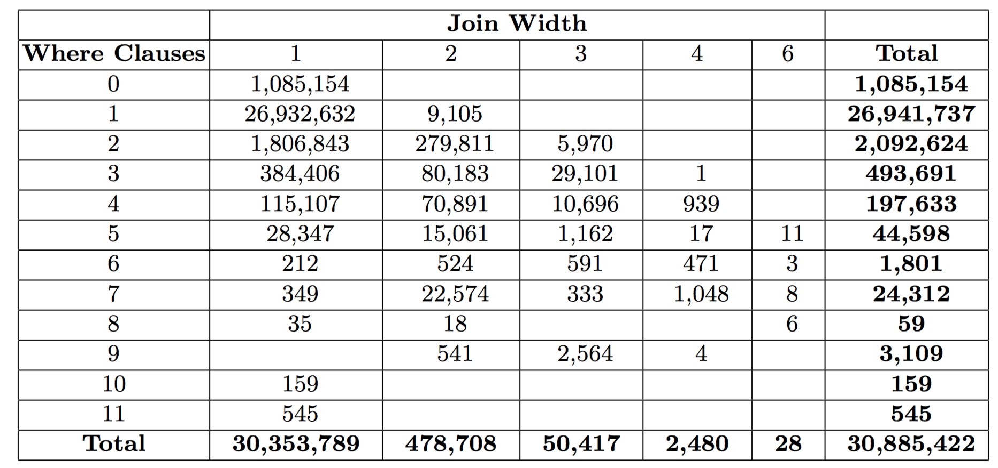
Observations from ‘Pocket Data: The Need for TPC-MOBILE’ paper
Reference: http://odin.cse.buffalo.edu/wp-content/uploads/2015/06/2015-TPCTC-SQLite-submitted.pdf

Slide 8
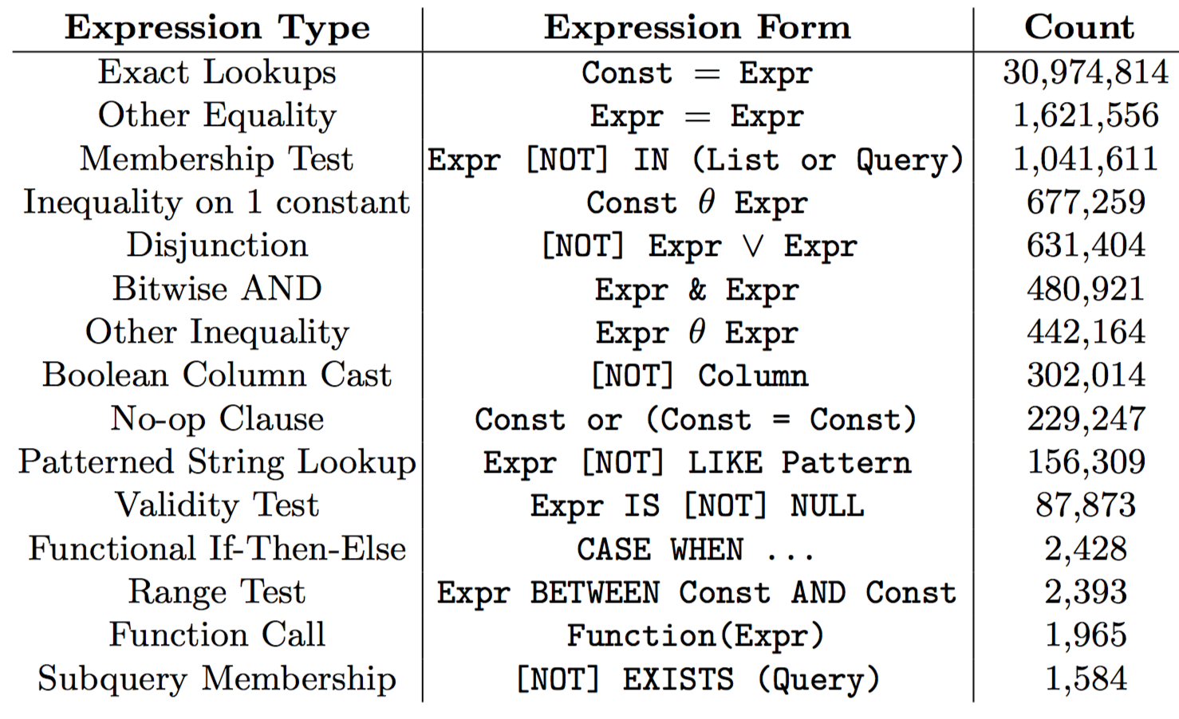
Observations from ‘Pocket Data: The Need for TPC-MOBILE’ paper
Reference: http://odin.cse.buffalo.edu/wp-content/uploads/2015/06/2015-TPCTC-SQLite-submitted.pdf

Slide 9
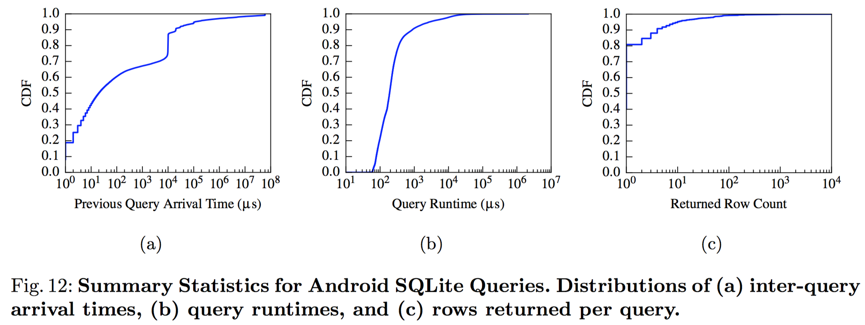
Observations from ‘Pocket Data: The Need for TPC-MOBILE’ paper
20% queries periodic (File Locks?)
85% queries run in 0.1ms
80% queries returned single row (key-value lookup)
Reference: http://odin.cse.buffalo.edu/wp-content/uploads/2015/06/2015-TPCTC-SQLite-submitted.pdf

Slide 10
Ideation
Analysis per Application (Read % , Read/Write ratio)
Long tail distribution skews results.
Cluster based analysis
Analyze patterns within cluster
Generalize the behavior
Explain the behavior
How certain that a new app of this cluster will behave same?

Slide 11
Ideation
Cluster Analysis [Contd..]
Finding similar clusters for each feature. Combine them into one if they behave same.
Split a cluster into two if there are two sets of query access patterns and they can be explained.
Frequency of app usage within cluster should not demand different benchmarks.
It should be driven by scale factor and burst factors?

Slide 12
Steps ahead
Identifying and finalizing the right features
Phone data log file extraction.
Implement the ideas.
Per app basis analysis & cluster based analysis

